Slide 1
Multiple Linear Regression

Slide 2
What is MLR
Multiple linear regression is used to estimate the relationship between two or more independent variables and one dependent variable.

Slide 3
What multiple linear regression can help you do.
You can use multiple linear regression when you want to know:
How strong the relationship is between two or more independent variables and one dependent variable (e.g. how rainfall, temperature, and amount of fertilizer added affect crop growth).
The value of the dependent variable at a certain value of the independent variables (e.g. the expected yield of a crop at certain levels of rainfall, temperature, and fertilizer addition).

Slide 4
Assumptions of multiple linear regression
Multiple linear regression makes all of the same assumptions as simple linear regression:
The probability distribution of ε is normal.
The mean of ε is zero: E(ε) = 0.
The standard deviation of ε is σ_{ε} for all values of X.
The set of errors associated with different values of Y are all independent

Slide 5

The formula for a multiple linear regression is:
y = the predicted value of the dependent variable
B₀ = the y-intercept (value of y when all other parameters are set to 0)
B₁X₁= the regression coefficient (B₁) of the first independent variable (X₁) (a.k.a. the effect that increasing the value of the independent variable has on the predicted y value)
… = do the same for however many independent variables you are testing
B_{n}X_{n} = the regression coefficient of the last independent variable
e = model error (a.k.a. how much variation there is in our estimate of y)

Slide 6
To find the best-fit line for each independent variable, multiple linear regression calculates three things:
The regression coefficients that lead to the smallest overall model error.
The t-statistic of the overall model.
The associated p-value (how likely it is that the t-statistic would have occurred by chance if the null hypothesis of no relationship between the independent and dependent variables was true).

Slide 7
T-Score Vs P-Value
T-Score (T-Statistic): The T-score measures how many standard errors a coefficient estimate is away from zero.
In simple terms, it tells you how "big" or "small" the effect of a particular independent variable is on the dependent variable. If the T-score is large, it means the variable has a stronger influence. If it's small, the influence is weaker.
P-Value: The p-value associated with each T-score indicates the probability of observing the relationship between the independent variable and the dependent variable by random chance, assuming there's no actual relationship.
In other words, a small p-value (typically below a predetermined significance level, like 0.05) suggests that the variable is likely to be a significant predictor of the outcome.
On the other hand, a large p-value suggests that the variable may not be an important predictor

Slide 8
Imagine you're trying to predict a student's final exam score based on two factors: the number of hours they studied (X1) and the number of hours they slept the night before (X2). You run a multiple linear regression analysis and get the following results:
Number of Hours Studied (X1): T-score = 3.5, P-value = 0.002
Number of Hours Slept (X2): T-score = 1.2, P-value = 0.24
In this example, the T-score for "Number of Hours Studied" is relatively large (3.5), and the p-value is very small (0.002). This suggests that the number of hours studied is a significant predictor of the final exam score.
On the other hand, the T-score for "Number of Hours Slept" is relatively small (1.2), and the p-value is relatively large (0.24). This indicates that the number of hours slept is not a significant predictor of the final exam score.
Hence, the T-score and p-value help you determine which independent variables have a meaningful impact on the dependent variable in a multiple linear regression analysis. Small p-values and large T-scores indicate variables that are more likely to be important in making predictions, while large p-values and small T-scores suggest that a variable may not be a significant predictor.

Slide 9
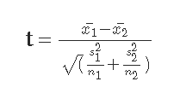
T-test
In statistics, the t-statistic is the ratio of the departure of the estimated value of a parameter from its hypothesized value to its standard error’
It is meant for evaluating whether the two sets of data are statistically significantly different from each other.

Slide 10
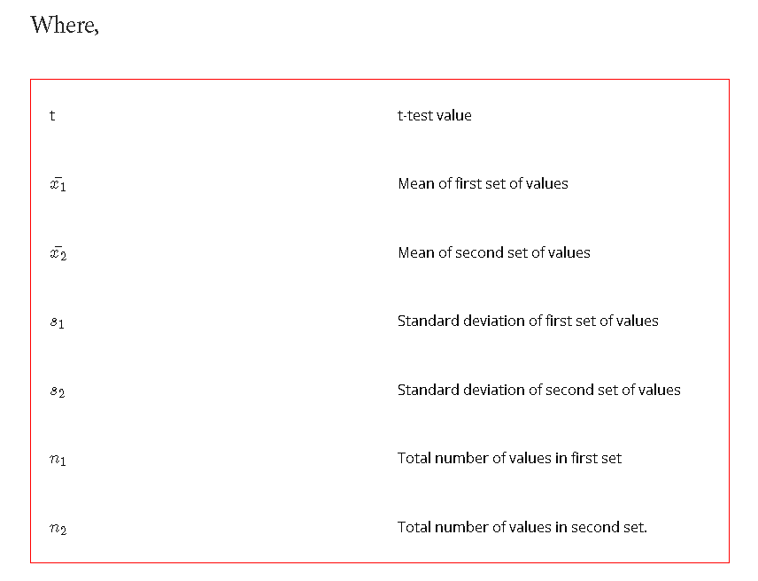

Slide 11
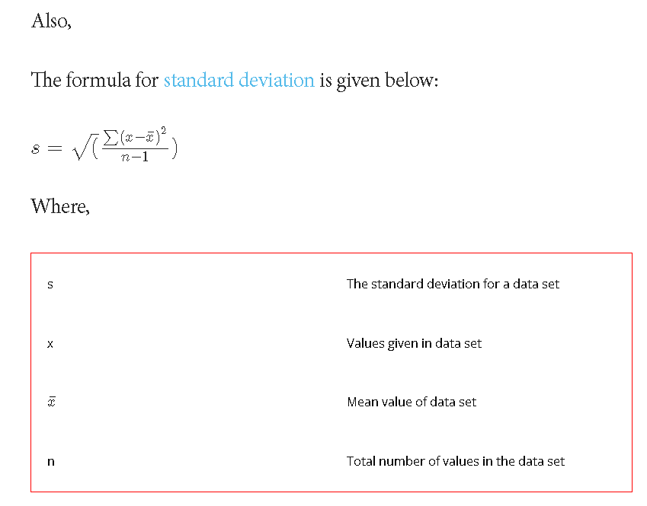

Slide 12
Q.1: Find the t-test value for the following given two sets of values:
A = 7, 2, 9, 8 and
B = 1, 2, 3, 4?
Solution: For first data set:
Number of terms in first set i.e. n_1 = 4
Calculate mean value for first data set using formula:

Slide 13
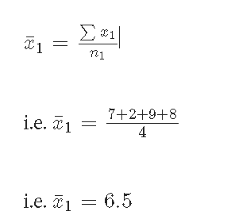

Slide 14
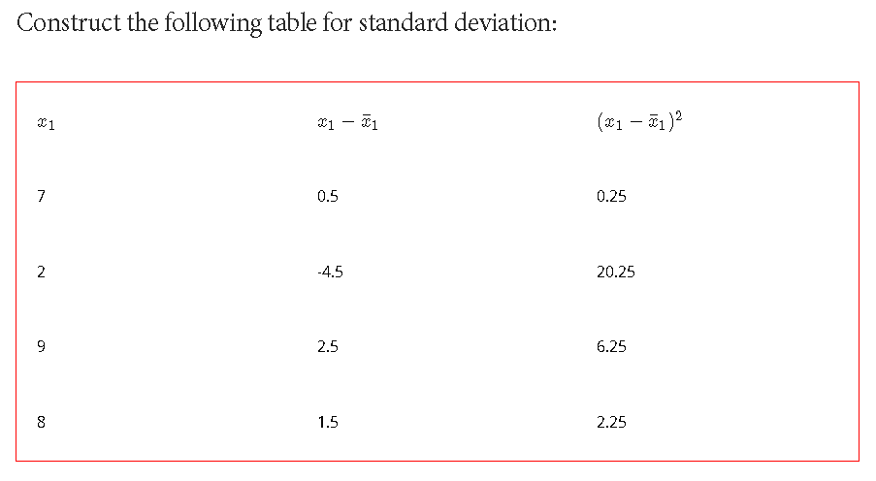

Slide 15
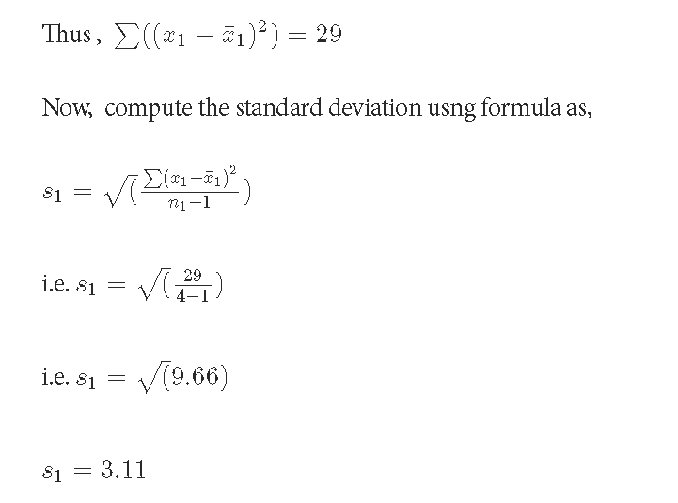

Slide 16
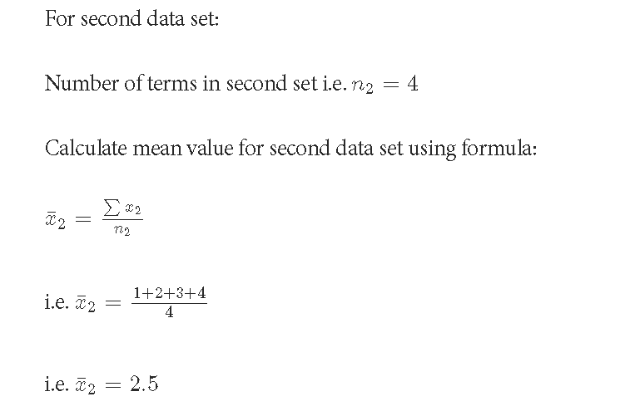

Slide 17
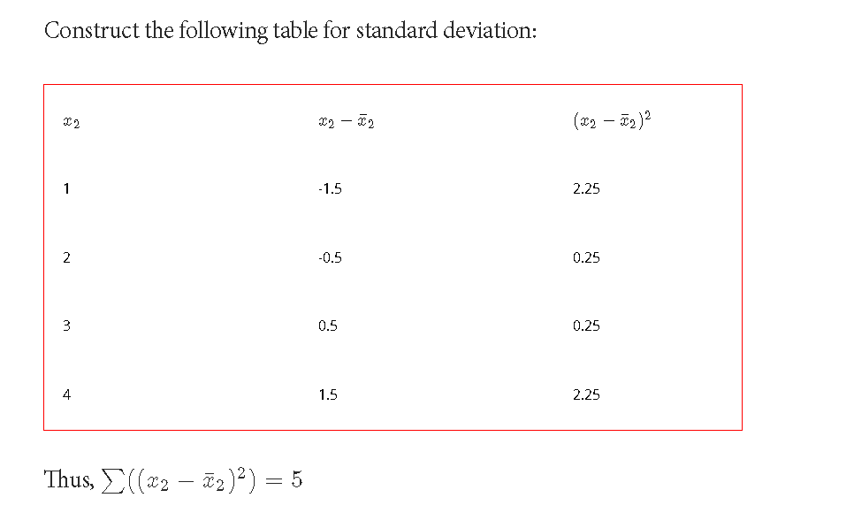

Slide 18
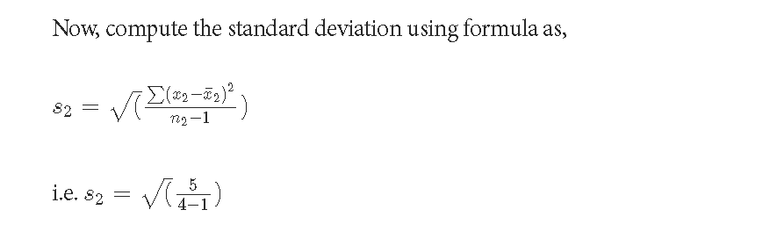


Slide 19
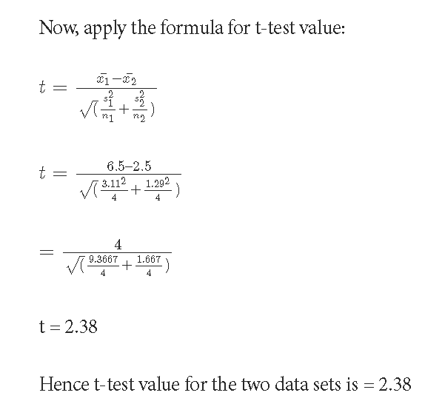

Slide 20
Higher values of the t-value, also called t-score, indicate that a large difference exists between the two sample sets. The smaller the t-value, the more similarity exists between the two sample sets.

Slide 21
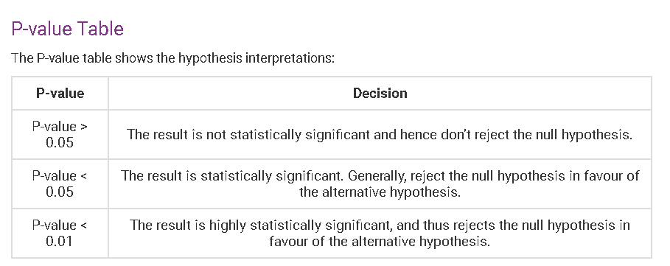
P-value
P-value is the lowest significance level that results in rejecting the null hypothesis.

Slide 22
In general, a smaller p-value indicates a more significant relationship between the independent variable and dependent variable, while a larger p-value indicates a weaker relationship.

Slide 23


Slide 24


Slide 25


Slide 26
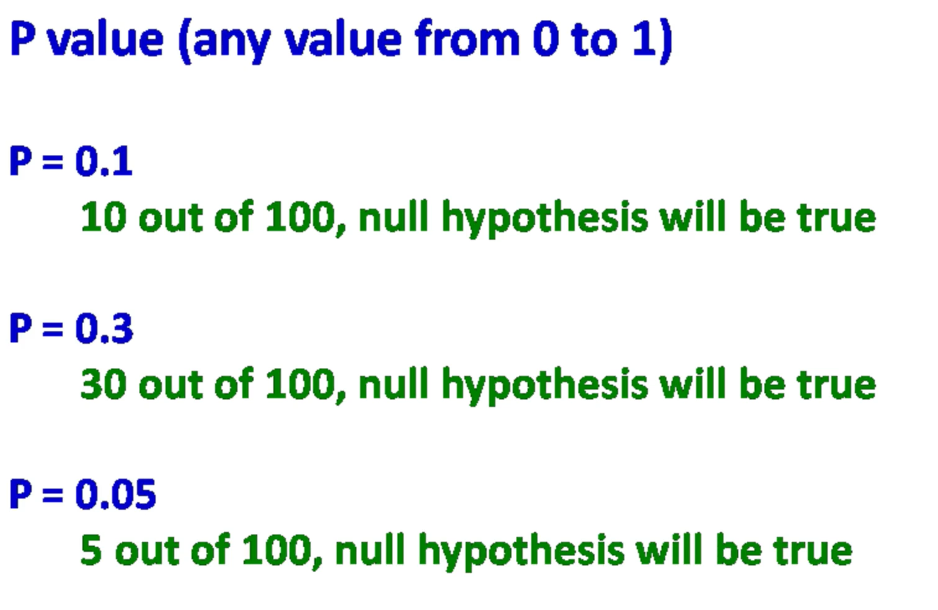

Slide 27


Slide 28
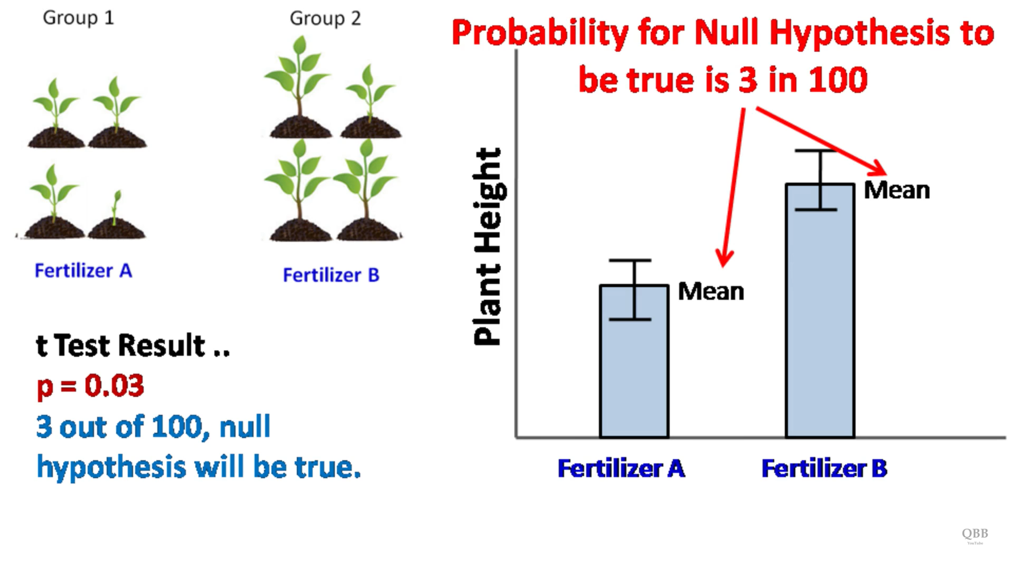

Slide 29
The null hypothesis typically assumes that there is no relationship between the independent variables and the dependent variable, or that the estimated coefficients for the independent variables are equal to zero

Slide 30
Example
Coin toss
Two possible outcomes
H0 = This is a fair coin
H1 = This is not a fair coin
The P-value test will assume that the H0 hypothesis is true i.e., the coin is fair
Let us assume our threshold value to be 5% i.e., 0.05

Slide 31
Let us assume the output is
First toss output is Tail (probability = 0.5)
First toss output is Tail and second toss output is also Tail (probability = 0.25)
First two outputs same as before, third toss output is also Tail (probability = 0.125)
First three outputs same as before, fourth toss output is also Tail (probability = 0.0625)
First four outputs same as before, fifth toss output is also Tail (probability = 0.03)
First five outputs same as before, sixth toss output is also Tail (probability = 0.01)
After the fourth output the statistical test is significant. Since P-value of less than 5% indicates that the hypothesis H0 is rejected and hypothesis H1 is accepted i.e., the coin is not fair

Slide 32
Implementing MLR in python

Slide 33
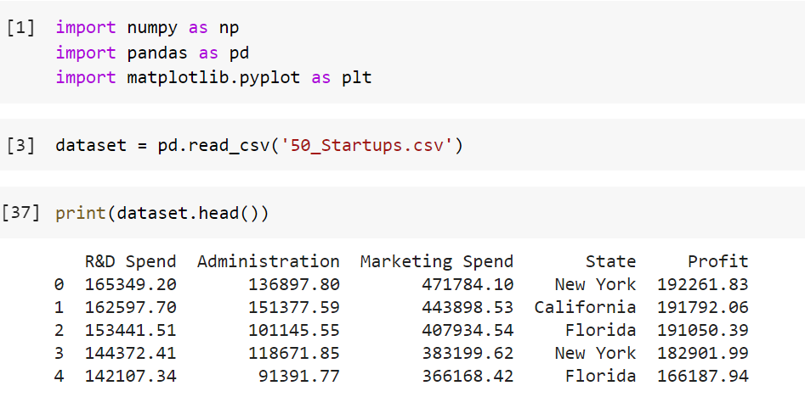
Code

Slide 34
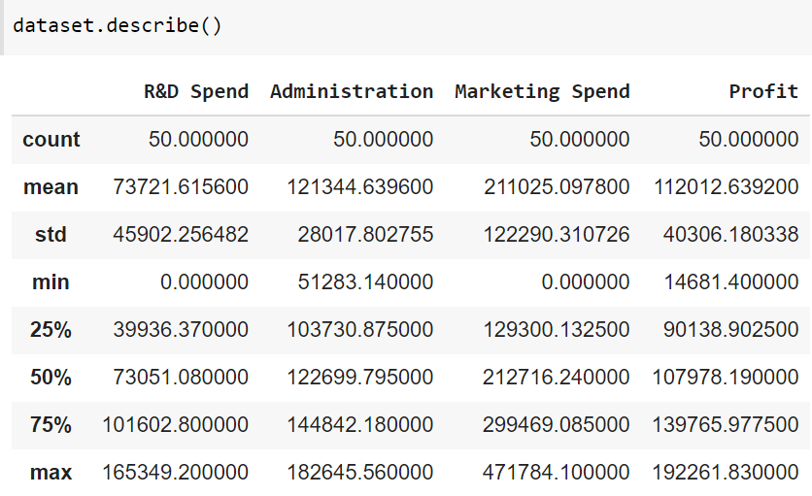

Slide 35
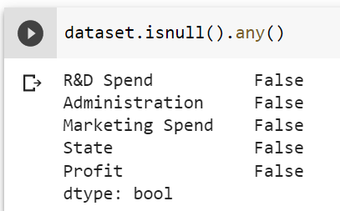

Slide 36
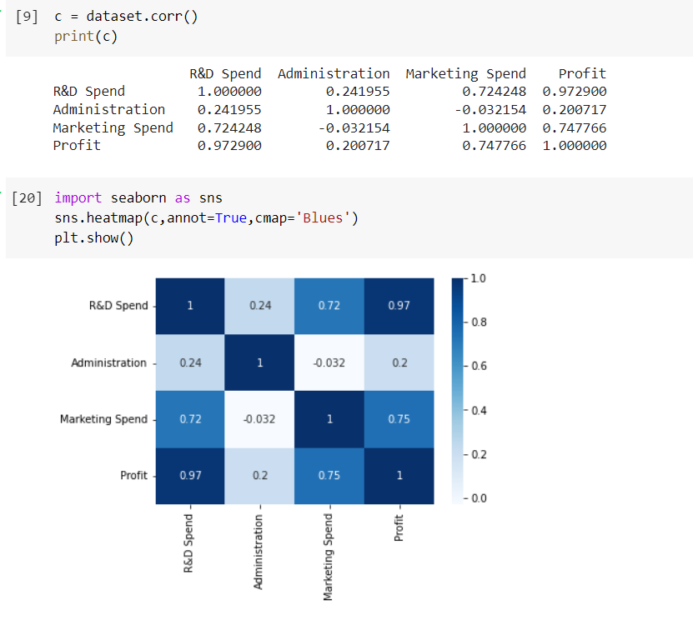

Slide 37
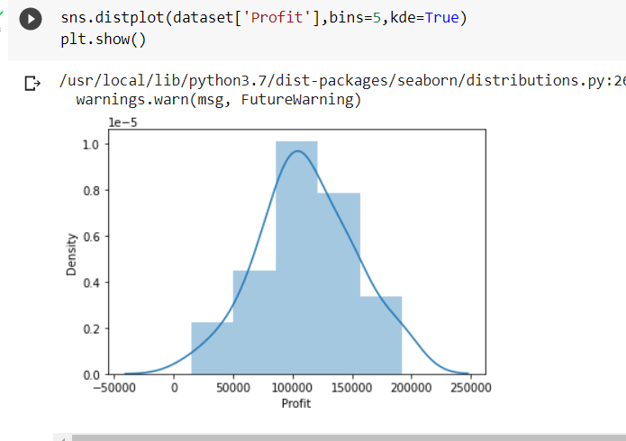

Slide 38
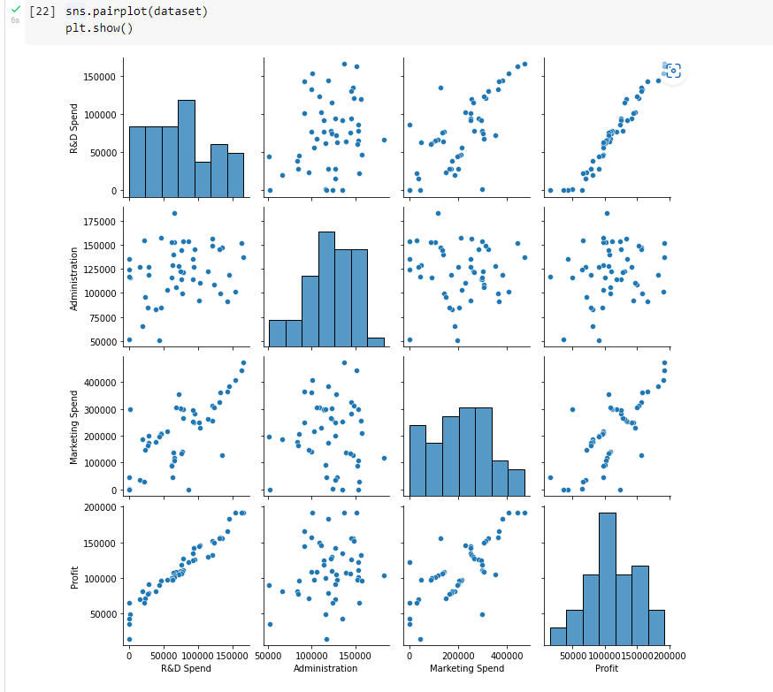

Slide 39
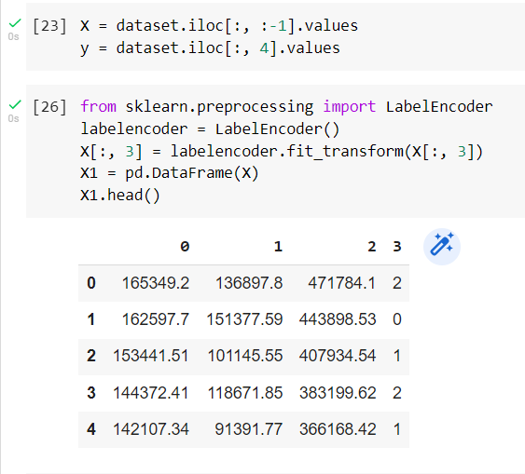
Encoding

Slide 40
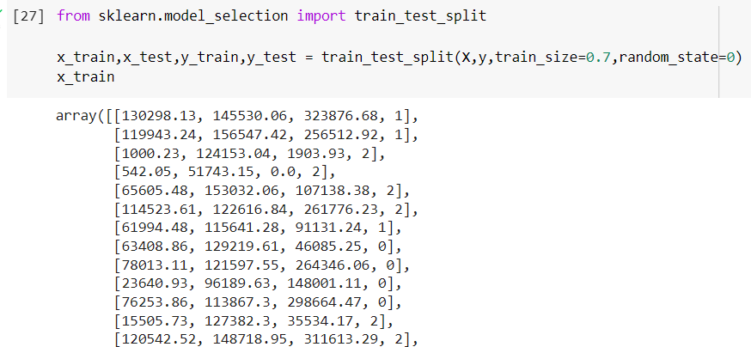

Slide 41
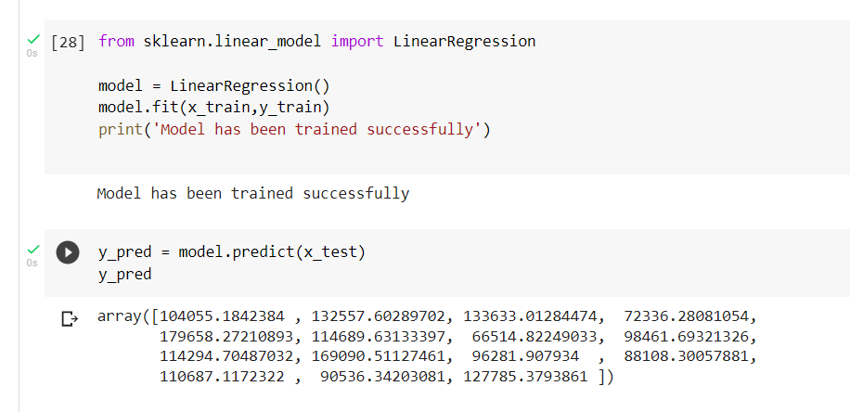
Training the model

Slide 42
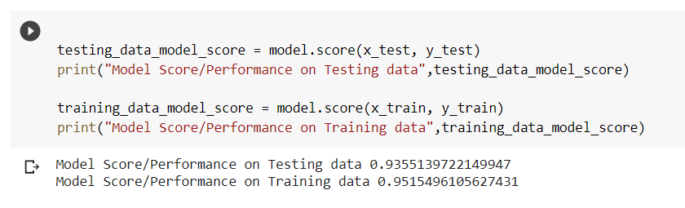
Testing the model

Slide 43
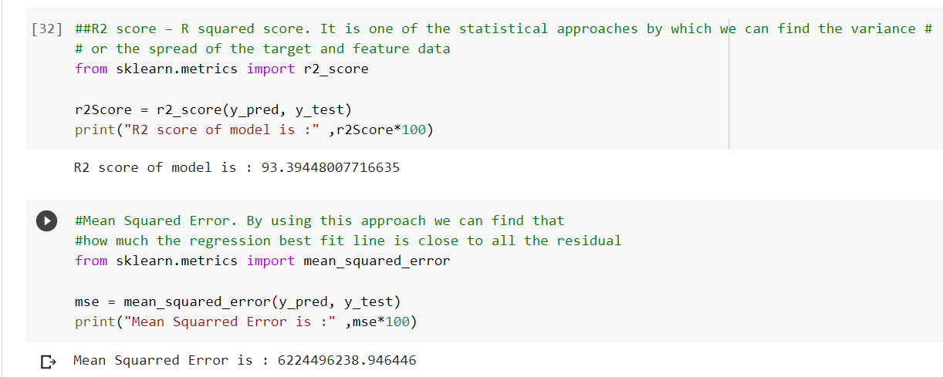
Model Evaluation
R2 = Explained variance / Total variance
The explained variance is the sum of the squared differences between the predicted values and the mean of the dependent variable, and the total variance is the sum of the squared differences between the actual values and the mean of the dependent variable

Slide 44
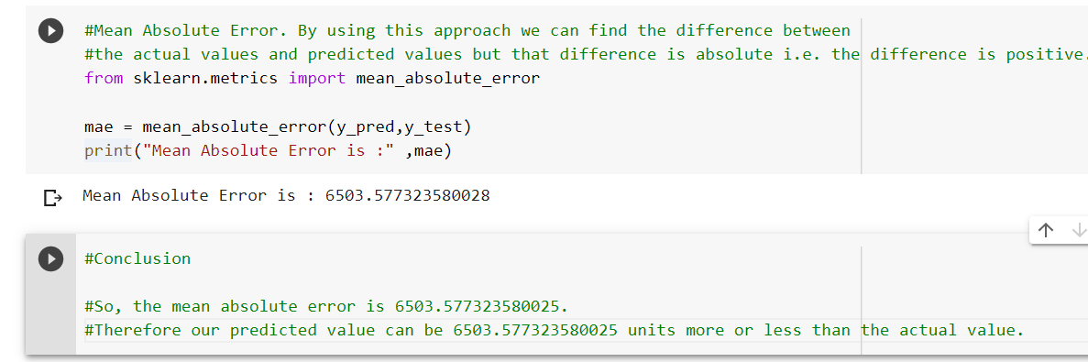
Conclusion

